Slide 1
Introduction To Sonic Pi
Sonic pi is a new kind of musical instrument, designed for creating sounds with code.

Slide 2

How To Download And Install Sonic Pi
-First go to this website: https://sonic-pi.net/
-Once you are on the website, scroll down a bit and you should find three pink buttons saying Windows, MacOS and Raspberry Pi
-Click on the button that works for your computer and it will take you to where you can download Sonic Pi
-If your computer is Windows, once you’ve clicked the Windows button and it’s taken you to where to download, click on the MSI Installer
-After clicking that it should begin to download

Slide 3
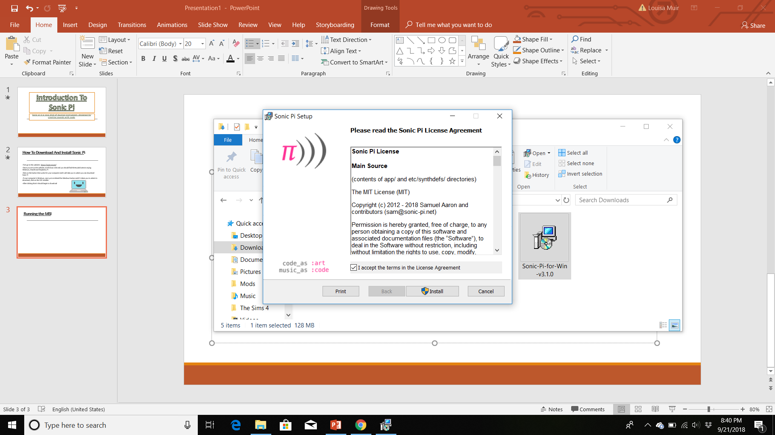
Running the MSI
-Go into the downloads on your files
-Click on the Sonic Pi download, and then you should be able to install it.
-Once that has installed Sonic Pi will load up straight away

Slide 4

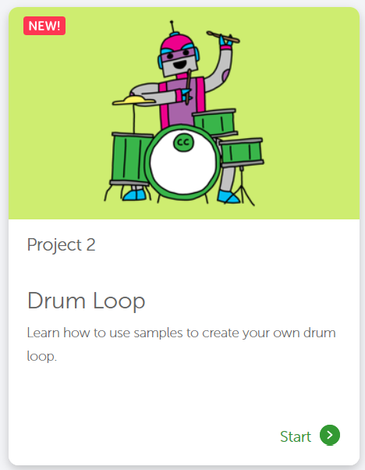
The Tutorial
-Go to this website- https://codeclubprojects.org/en-GB/sonic-pi/
-Once you are on the website click on Drum Loop and then we can start the tutorial

